Slide 1
LECTURE SLIDE - 7
Chapter 7: Parallel dc Circuits
*
1

Slide 2
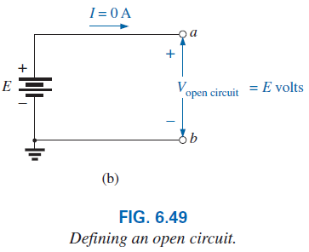
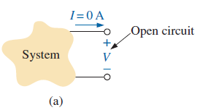
6.8 Open and Short Circuits
An open circuit is two isolated terminals not connected by an element of any kind, as shown in Fig. 6.49(a).
Since a path for conduction does not exist, the current associated with an open circuit must always be zero.
An open circuit can have a potential difference (voltage) across its terminals, but the current is always zero amperes.
In Fig. 6.49(b), an open circuit exists between terminals a and b. The voltage across the open-circuit terminals is the supply voltage, but the current is zero due to the absence of a complete circuit.
*
2

Slide 3
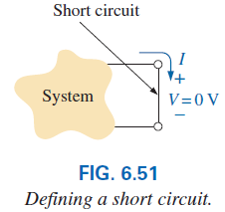
6.8 Short Circuit
A short circuit is a very low resistance, direct connection between two terminals of a network, as shown in Fig. 6.51.
The current through the short circuit can be any value, as determined by the system it is connected to, but the voltage across the short circuit is always zero volts because the resistance of the short circuit is assumed to be essentially zero ohms and V = IR = I(0 ) Ω = 0 V.
In summary, a short circuit can carry a current of a level determined by the external circuit, but the potential difference (voltage) across its terminals is always zero volts.
*
3

Slide 4
6.8 Open and Short Circuit
The terminology short circuit or open circuit is usually associated with dire situations such as power loss, smoke, or fire.
However, in network analysis, both can play an integral role in determining specific parameters about a system.
Most often, however, if a short-circuit condition is to be established, it is accomplished with a jumper—a lead of negligible resistance to be connected between the points of interest.
Establishing an open circuit just requires making sure that the terminals of interest are isolated from each other.
Examples: 6.25, 6.26, 6.27, 6.28
*
4

Slide 5
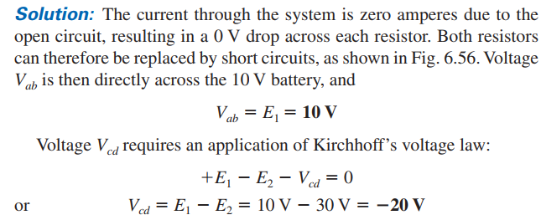
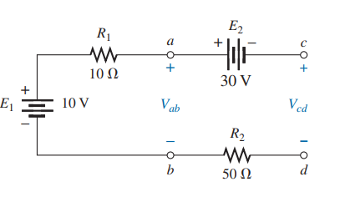
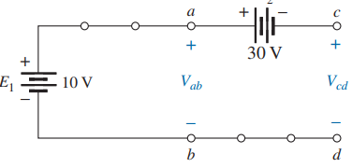
*
5

Slide 6
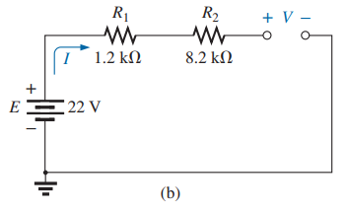
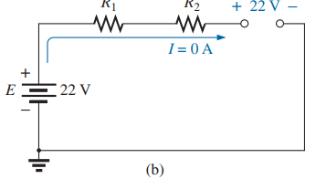
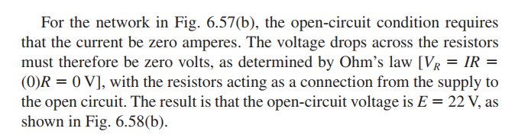
*
6

Slide 7
6.9 Voltmeter Loading Effects
Self study
*
7

Slide 8
6.10 Duality Principle
The equations for the series and parallel configurations have a number of similarities. In fact, the equations for one can often be obtained directly from the other by simply applying the duality principle.
Duality between equations means that the format for an equation can be applied to two different situations by just changing the variable of interest.
For instance, the equation for the total resistance of a series circuit is the sum of the resistances. By changing the resistance parameters to conductance parameters, you can obtain the equation for the total conductance of a parallel network—an easy way to remember the two equations.
*
8

Slide 9
6.10 Duality Principle
Similarly, by starting with the total conductance equation, you can easily write the total resistance equation for series circuits by replacing the conductance parameters by resistance parameters.
Series and parallel networks share two important dual relationships:
(1) between resistance of series circuits and conductance of parallel circuits and
(2) between the voltage or current of a series circuit and the current or voltage, respectively, of a parallel circuit.
*
9

Slide 10
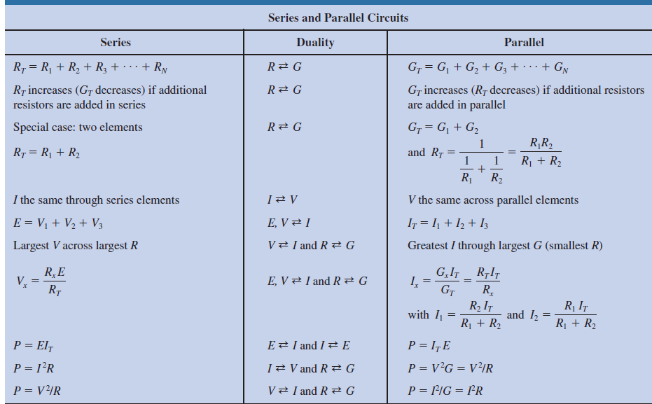
6.10 Summary Table
*
10

Slide 11
6.13 Applications
One of the most important advantages of the parallel configuration is that if one branch of the configuration should fail (open circuit), the remaining branches will still have full operating power.
Another important advantage is that branches can be added at any time without affecting the behavior of those already in place.
Some Common Applications are:
1. Car System
2. House Wiring
3. Parallel Computer Bus Connections
*
11

Slide 12

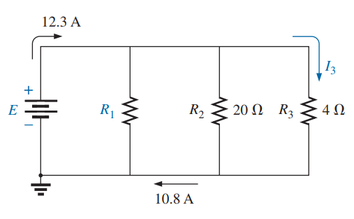


*
12

Slide 13
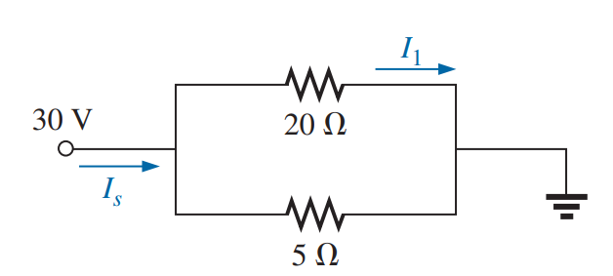

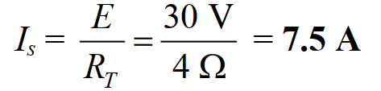
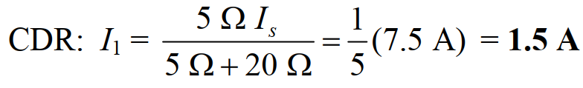
*
13

Slide 14

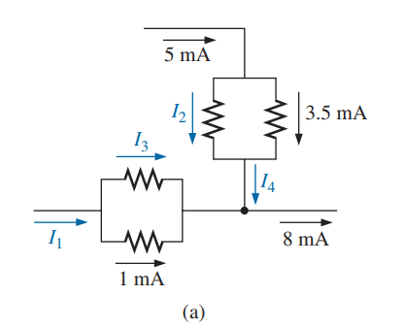


*
14

Slide 15
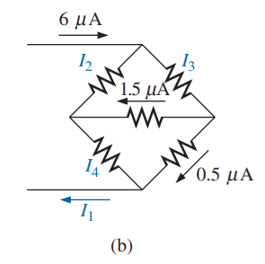



*
15

Slide 16

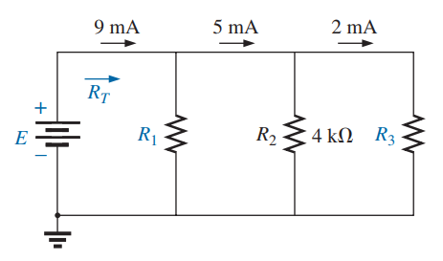




*
16

Slide 17
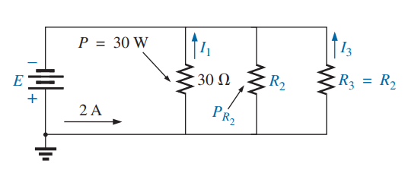
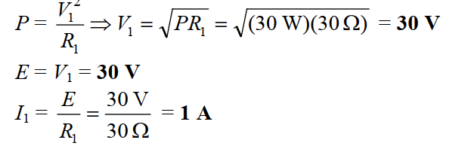
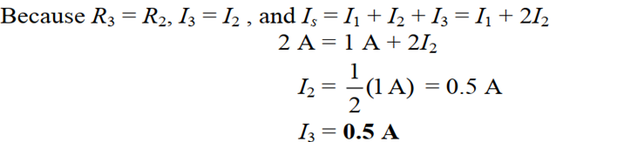
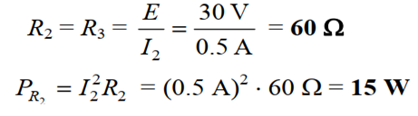
*
17

Slide 18
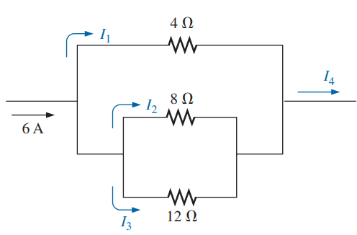
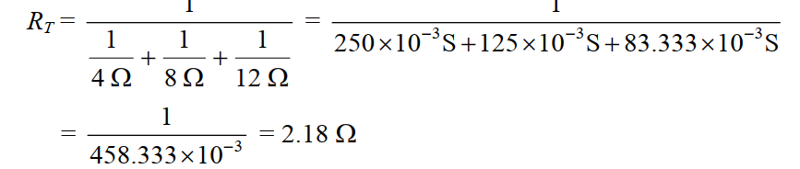
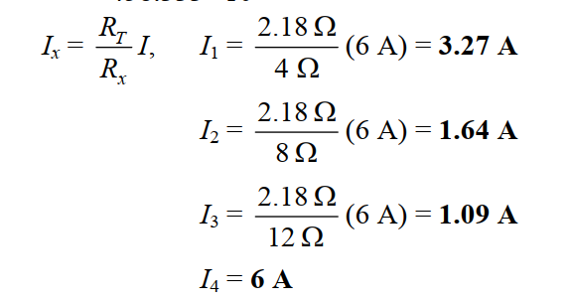
*
18

Slide 19
Thank You
*
19

